Slide 1
Networking
Course Outline
1. Introduction
2. Basics of Networking
3. Goals of Network Security
4. Network Protocols
5. 3 way Handshake
6. OSI model
7. Ip addresses
8. DHCP

Slide 2
Networking
9. DNS
10. Subnetting
11. SNMP
12. ARP
13. Wi-Fi
14. Nmap

Slide 3

Networking

Slide 4
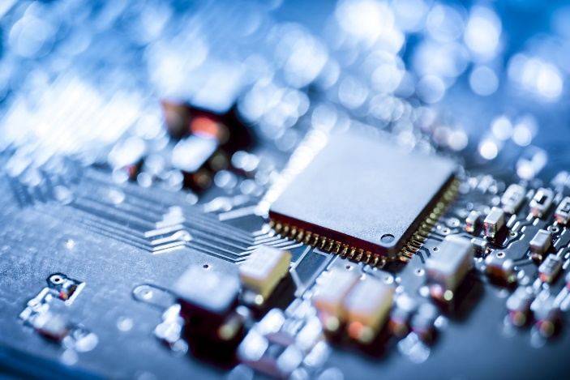
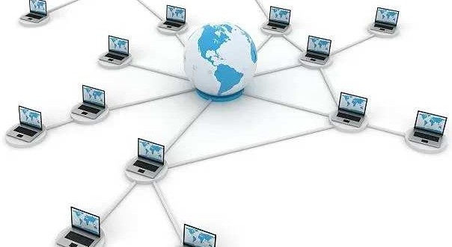
Network?
Two or more computers exchanging information over wire
or wireless

Slide 5

Key Terms
LAN
WAN MAN

Slide 6
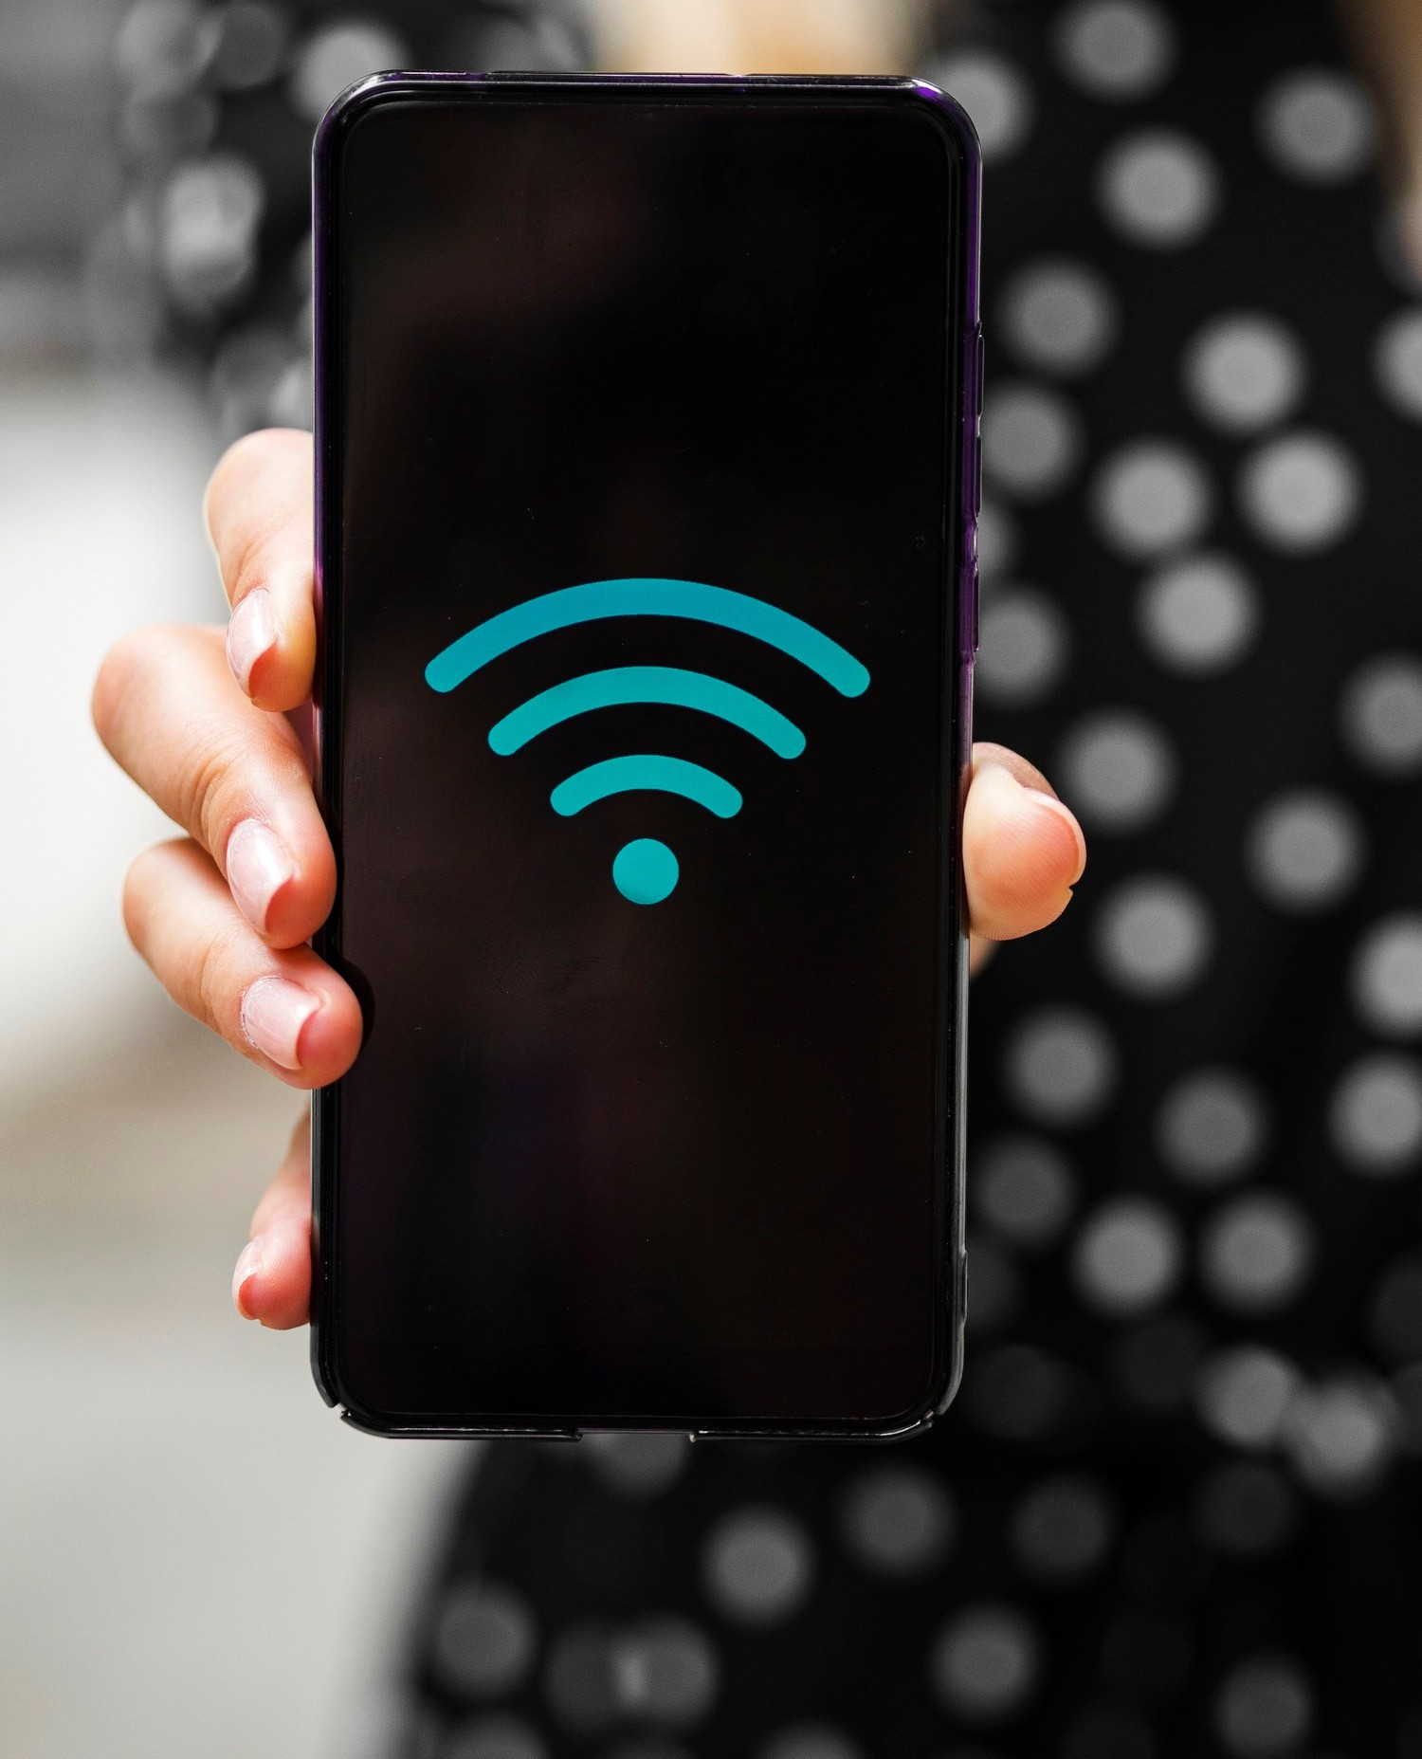
Why Network?
Share Files
Share Resources Share Programs

Slide 7
Key Elements of a Network
Network Interface Card or NIC
Network Cable
Network Hub
Network Switch
Network Router Wireless Network

Slide 8
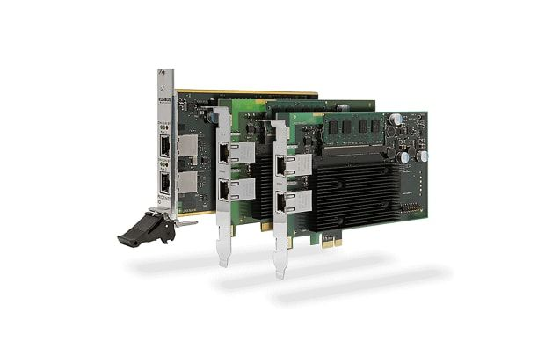
https://media.rs-online.com/image/upload/w_620,h_413,c_crop,c_pad,b_white,f_auto,q_auto/dpr_auto/v1552412067/Y1825587-01.jpg
Network Interface card

Slide 9
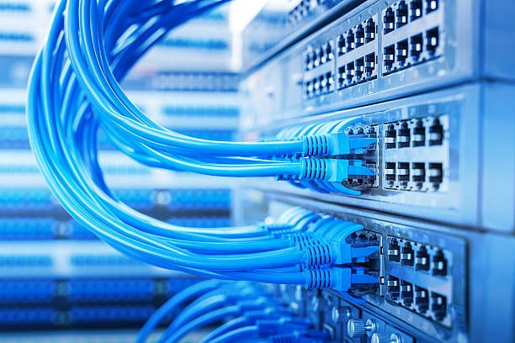
https://media.rs-online.com/image/upload_620,h_413,c_crop,c_pad,b_white,f_auto,q_auto/dpr_auto/v1552412067/Y1825587-01.jpg
Network Cable

Slide 10
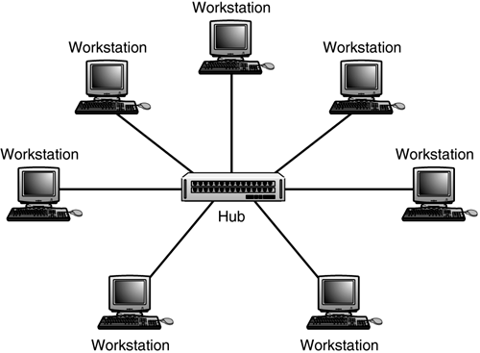
https://media.rs-online.com/image/uplw_620,h_413,c_crop,c_pad,b_white,f_auto,q_auto/dpr_auto/v1552412067/Y1825587-01.jpg
Hub

Slide 11
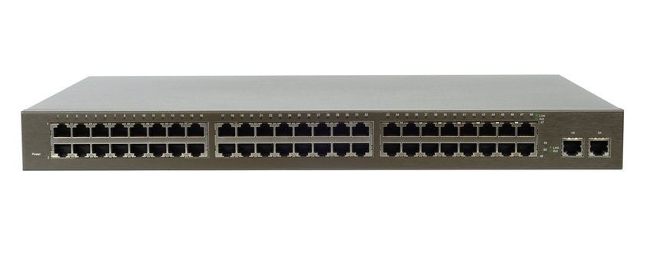
https://media.rs-online.com/image/uplow_620,h_413,c_crop,c_pad,b_white,f_auto,q_auto/dpr_auto/v1552412067/Y1825587-01.jpg
Switch

Slide 12
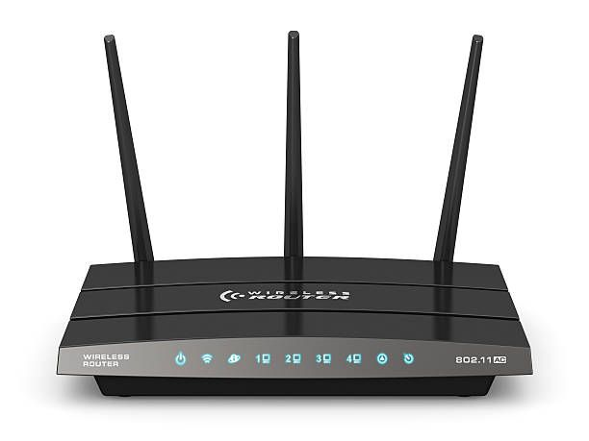
https://media.rs-online.com/image/upload/w_620,h_413,c_crop,c_pad,b_white,f_auto,q_auto/dpr_auto/v1552412067/Y1825587-01.jpg
Router

Slide 13
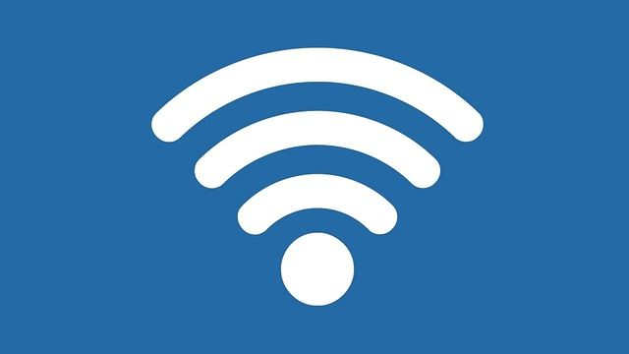
https://media.rs-online.com/image/upload/w_620,h_413,c_crop,c_pad,b_white,f_auto,q_auto/dpr_auto/v1552412067/Y1825587-01.jpg
Wireless Network

Slide 14

Network Topolgy
BUS
STAR RING
MESH

Slide 15
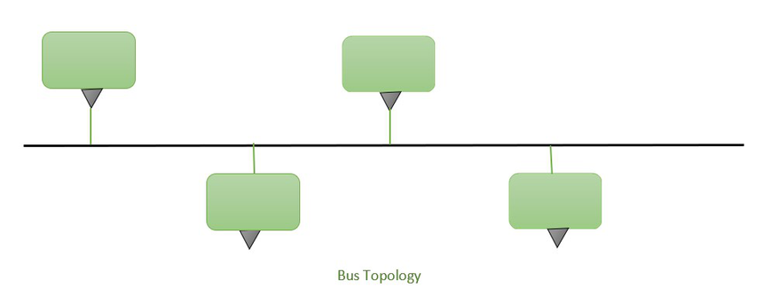
https://media.rs-online.com/imagd/w_620,h_413,c_crop,c_pad,b_white,f_auto,q_auto/dpr_auto/v1552412067/Y1825587-01.jpg
BUS Topology

Slide 16
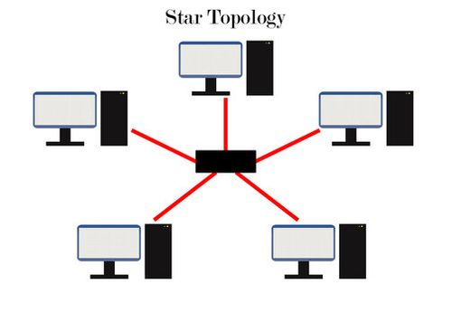
https://media.rs-online.com/imagd/w_620,h_413,c_crop,c_pad,b_white,f_auto,q_auto/dpr_auto/v1552412067/Y1825587-01.jpg
STAR Topology

Slide 17
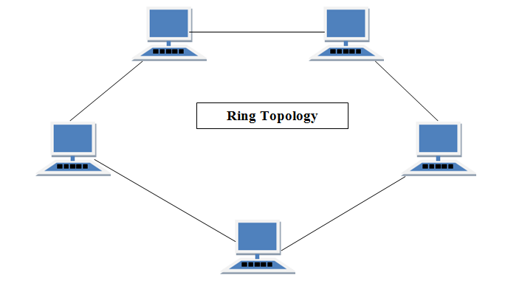
https://media.rs-online.com/imagd/w_620,h_413,c_crop,c_pad,b_white,f_auto,q_auto/dpr_auto/v1552412067/Y1825587-01.jpg
RING Topology

Slide 18
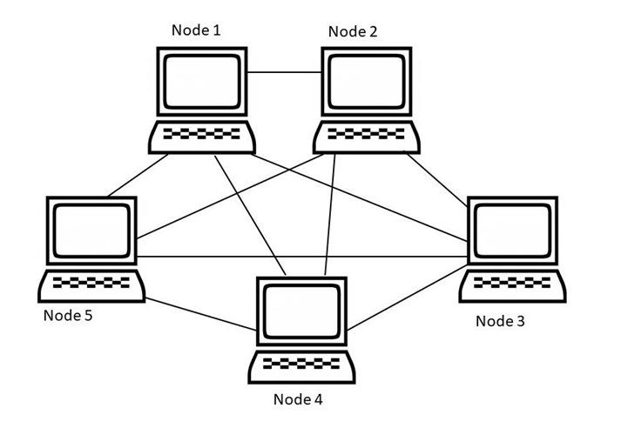
https://media.rs-online.com/imagd/w_620,h_413,c_crop,c_pad,b_white,f_auto,q_auto/dpr_auto/v1552412067/Y1825587-01.jpg
MESH Topology

Slide 19

Confidentiality
Integrity
Availability
Authentication
Authorization
Encryption
Accountability and Auditing
Incident Response and Recovery
Goals of Network Security: to protect data
Confidentiality
Integrity
Availability
Authentication
Authorization
Encryption
Accountability and Auditing
Incident Response and Recovery

Slide 20
Confidentiality
Integrity
Availability
Authentication
Authorization
Encryption
Accountability and Auditing
Incident Response and Recovery
Network Protocols
Network protocols are like languages that computers use to communicate with each other over a network.
Just as people need a common language to understand each other, computers need protocols to exchange information effectively.

Slide 21
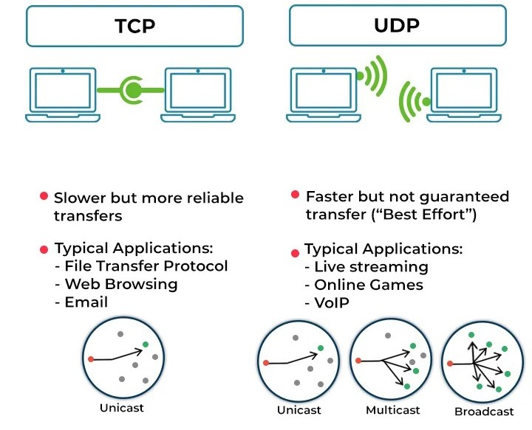
Confidentiality
Integrity
Availability
Authentication
Authorization
Encryption
Accountability and Auditing
Incident Response and Recovery

Slide 22
Confidentiality
Integrity
Availability
Authentication
Authorization
Encryption
Accountability and Auditing
Incident Response and Recovery
3-way Handshake
The 3-way handshake is a process used in computer networking to establish a reliable connection between two devices, typically in the context of the Transmission Control Protocol (TCP).
It ensures that both devices agree to establish a connection before data is exchanged.

Slide 23
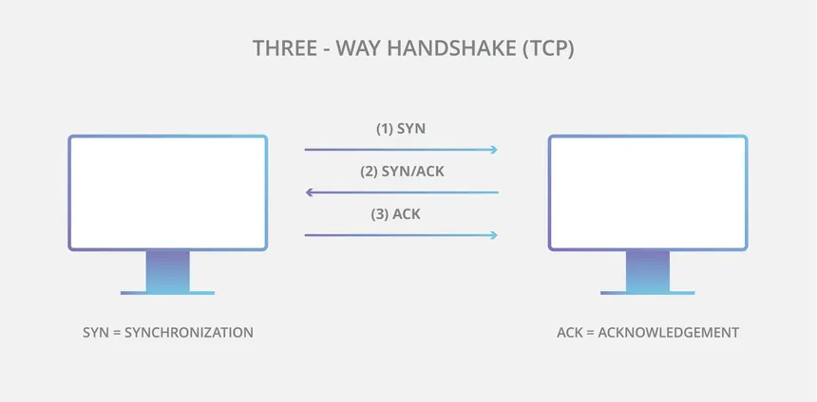

Slide 24
Confidentiality
Integrity
Availability
Authentication
Authorization
Encryption
Accountability and Auditing
Incident Response and Recovery
OSI MODEL
The Open Systems Interconnection (OSI) model describes seven layers that computer systems use to communicate over a network. It was the first standard model for network communications, adopted by all major computer and telecommunication companies in the early 1980s

Slide 25
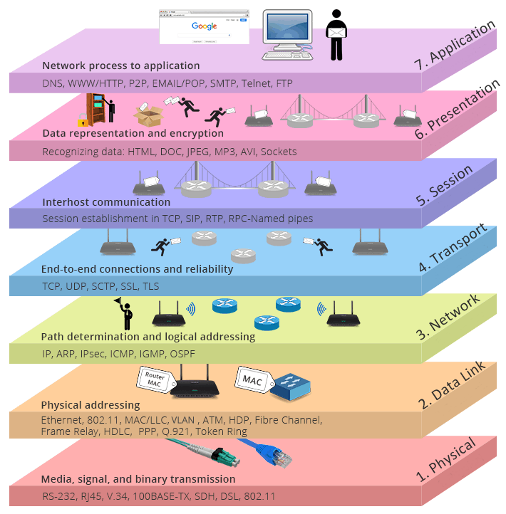

Slide 26
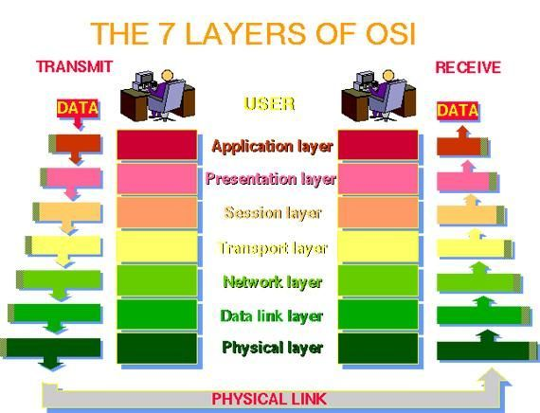

Slide 27
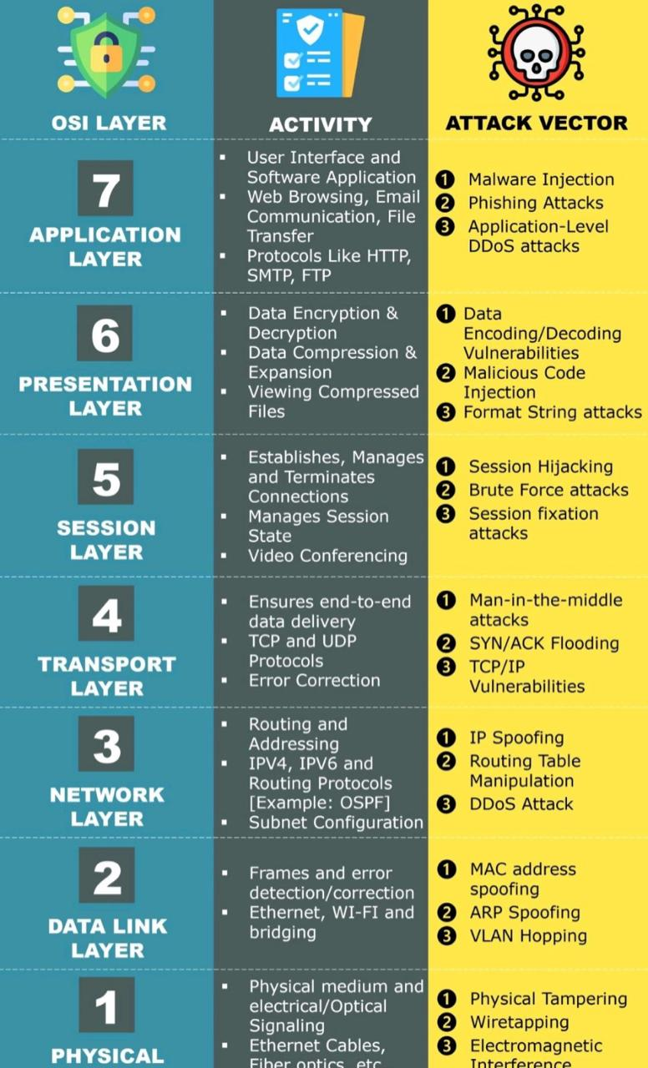

Slide 28
Confidentiality
Integrity
Availability
Authentication
Authorization
Encryption
Accountability and Auditing
Incident Response and Recovery
IP addresses
Every Device on TCP/IP network must have a unique ip address.
Most of devices use ipv4.
IPv4 is 32 bits
Looks something like 192.168.1.1
4.3billion IPv4 addresses.
IPV6 is 128 bits

Slide 29
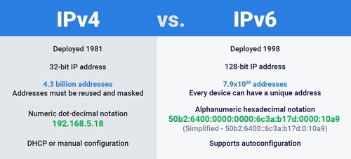

Slide 30
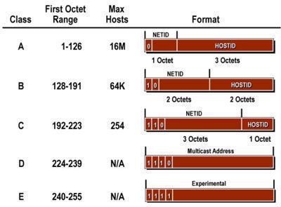

Slide 31
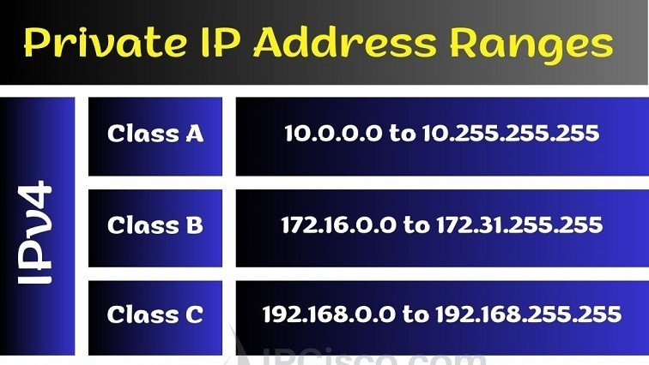

Slide 32
Confidentiality
Integrity
Availability
Authentication
Authorization
Encryption
Accountability and Auditing
Incident Response and Recovery
Subnetting
Subnetting is a technique used in computer networking to divide an IP network into smaller, more manageable parts called subnets.
It helps in efficiently using IP addresses and organizing a large network into smaller segments.
A subnet is a network within a network.
We can create subnets within class A, class B and class C network.

Slide 33
Confidentiality
Integrity
Availability
Authentication
Authorization
Encryption
Accountability and Auditing
Incident Ronse and Recovery
To do this, we use something called a subnet mask, which helps determine the network and host portions of an IP address.
192.168.102.1 -> 255.255.255.0
255.255.255.0 as "/24“ (CIDR notation)
255.255.0.0 as “/16”
255.0.0.0 as “/8”

Slide 34
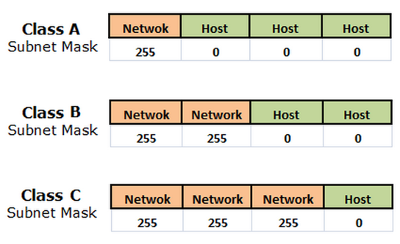

Slide 35
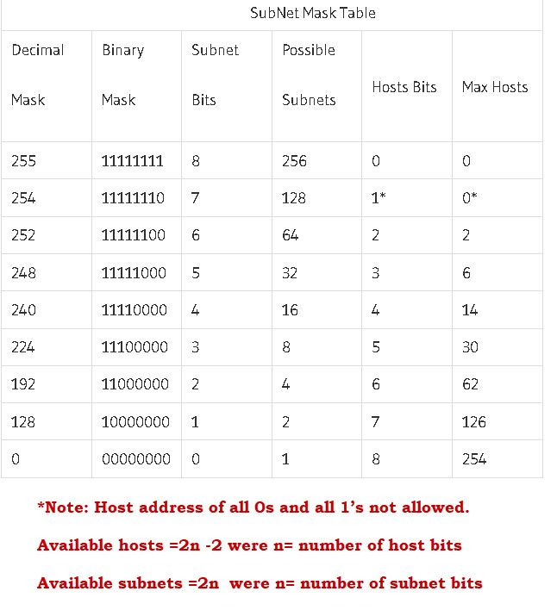
1 means part of the network
0 means part of the host

Slide 36
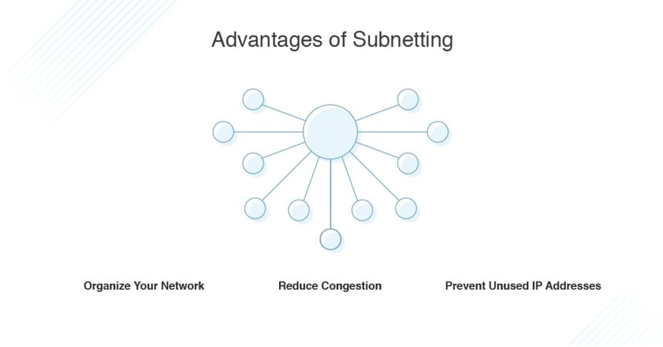

Slide 37
Confidentiality
Integrity
Availability
Authentication
Authorization
Encryption
Accountability and Auditing
Incident Response and Recovery
Mac Address
A MAC (Media Access Control) address is a unique identifier assigned to network interfaces for communications at the data link layer of a network.
It's usually represented as six pairs of hexadecimal digits, separated by colons or hyphens.
For example, "00:1A:2B:3C:4D:5E" or "00-1A-2B-3C-4D-5E.“
No two devices on a network can have the same mac-address.

Slide 38
Confidentiality
Integrity
Availability
Authentication
Authorization
Encryption
Accountability and Auditing
Incident Response and Recovery
DHCP
DHCP, or Dynamic Host Configuration Protocol, is a service that automatically assigns and manages IP addresses for devices on a network.
Requesting a new ip address from dhcp server in linux.
# sudo dhclient interface_name

Slide 39
Confidentiality
Integrity
Availability
Authentication
Authorization
Encryption
Accountability and Auditing
Incident Response and Recovery
DNS
DNS, or Domain Name System, is like a phone book for the internet.
Resolves names to numbers.
Instead of remembering IP addresses (a series of numbers) for websites, like trying to remember a phone number for every person you know, DNS lets you use easy-to-recall names (like www.example.com).

Slide 40
Confidentiality
Integrity
Availability
Authentication
Authorization
Encryption
Accountability and Auditing
Incident Response and Recovery
How it works
User Input
DNS Lookup
DNS Server Response
Establish Connection
Eg. www.openai.com

Slide 41
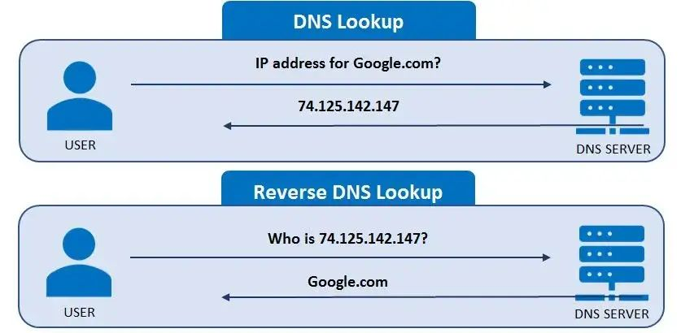

Slide 42
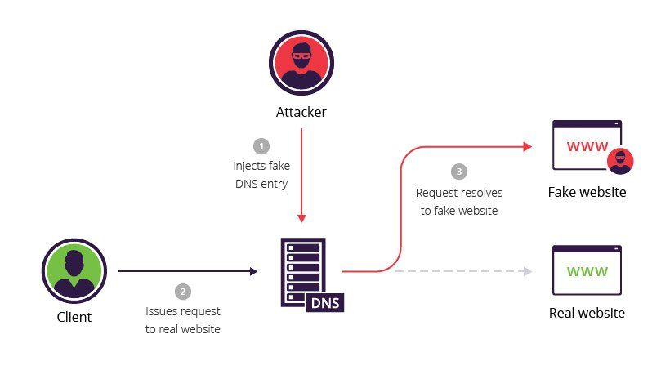
Confidentiality
Integrity
Availability
Authentication
Authorization
Encryption
Accountability and Auditing
Incident Response and Recovery
DNS poisoning

Slide 43
Confidentiality
Integrity
Availability
Authentication
Authorization
Encryption
Accountability and Auditing
Incident Response and Recovery
SNMP
Simple Network Management Protocol.
Allows network administrators to monitor and manage network devices such as routers, switches, servers, printers and more.
Operates at application layer.
# snmpcheck –t 192.168.1.1

Slide 44
Confidentiality
Integrity
Availability
Authentication
Authorization
Encryption
Accountability and Auditing
Incident Response and Recovery
ARP
Address Resolution Protocol.
Resolve ip address to the mac address.
arp –a display the current ARP (Address Resolution Protocol) cache on a computer. This cache contains a mapping of IP addresses to corresponding MAC (Media Access Control) addresses.

Slide 45
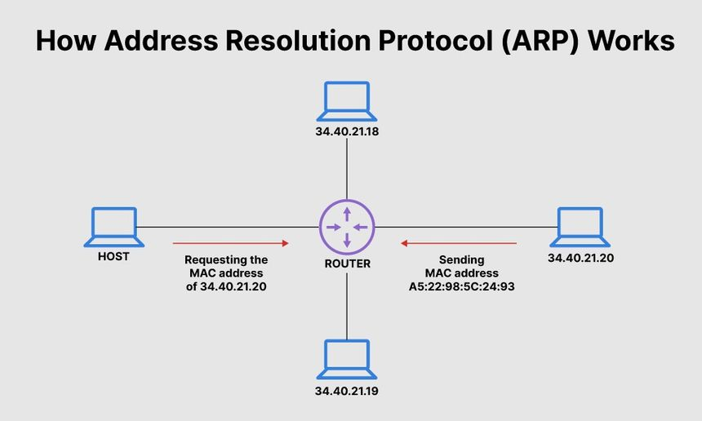

Slide 46
Confidentiality
Integrity
Availability
Authentication
Authorization
Encryption
Accountability and Auditing
Incident Response and Recovery
WI-FI
Wireless Fidelity, is a technology that allows devices to connect to the internet or communicate with each other wirelessly using radio waves.
Wi-Fi uses radio frequency signals to transmit data between devices. These signals operate in the 2.4 GHz and 5 GHz frequency bands, and they allow devices like smartphones, laptops, tablets, and other Wi-Fi-enabled devices to communicate without the need for physical cables.

Slide 47
Confidentiality
Integrity
Availability
Authentication
Authorization
Encryption
Accountability and Auditing
Incident Response and Recovery
AP (Access Point): client connect to the wifi and get internet access.
WLAN(Wireless Local Area Network).
BSSID (Basic Service Set Identifier): MAC address of the AP.
SSID (Service Set Identifier) : The 'name' of the AP.
Channels: channels 1 -14.

Slide 48
Confidentiality
Integrity
Availability
Authentication
Authorization
Encryption
Accountability and Auditing
Incident Response and Recovery
WIRELESS ENCRYPTION
WEP
WPA
WPA2
WPA3

Slide 49
Confidentiality
Integrity
Availability
Authentication
Authorization
Encryption
Accountability and Auditing
Incident Response and Recovery
MODES
MASTER
MANAGED
MONITOR
HACKERS OPERATE IN MONITOR MODE

Slide 50
Confidentiality
Integrity
Availability
Authentication
Authorization
Encryption
Accountability and Auditing
Incident Response and Recovery
Port Number
Port number is like a door number on a building, allowing data to enter or exit a computer or network.
A port number is a 16-bit unsigned integer, meaning it can range from 0 to 65,535.
when your computer communicates with another device over a network, it uses port numbers to specify which service or application should handle the incoming or outgoing data.

Slide 51
